Slide 1
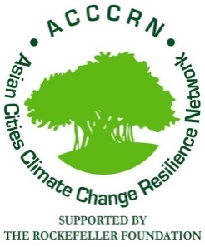
Urban Youth (16‐25)
Climate Change Adaptation Initiatives

Slide 2
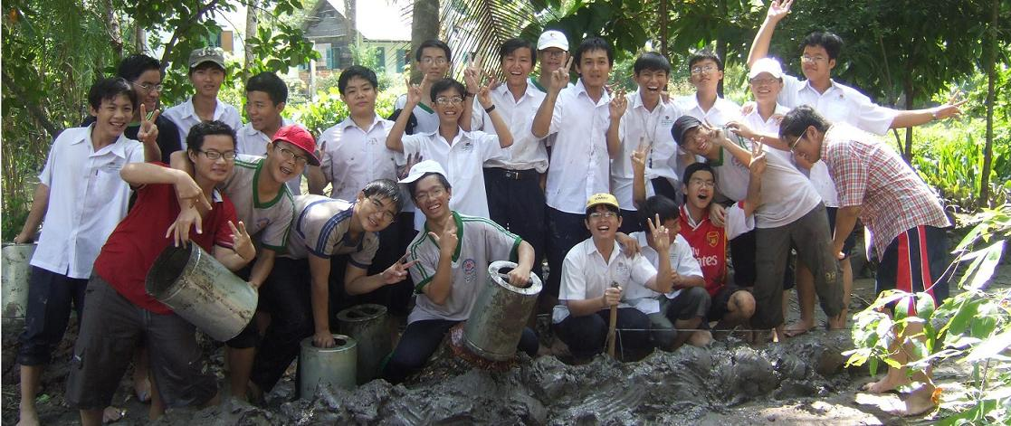
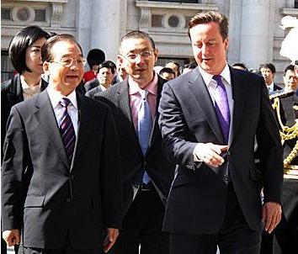
Youth are the
primary stakeholders of the medium-term
(5 to 50-year) future, the period when climate change will have its greatest impact.
.
In contrast, today’s adults are the main stakeholders of now, a time when climate change is not severe. When climate change becomes severe, today’s adults will retire, and have little reason to care. They will not need to cope with significant climate change.

Slide 3
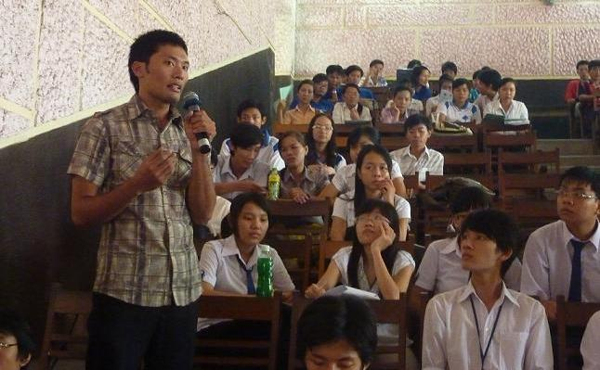
But Youth are marginalized from current decisions to cope with the future impacts of climate change.
In the 1970s, development practitioners like Robert Chambers learned the importance of including main stakeholders in planning and decision-making regardless of their social, political or economic status.
These ideas became known as ‘participatory approaches’ – PRA, PLA, PME etc.
The same participatory approaches of including the main stakeholders – Youth – in climate change plans and decisions, must now be applied.

Slide 4
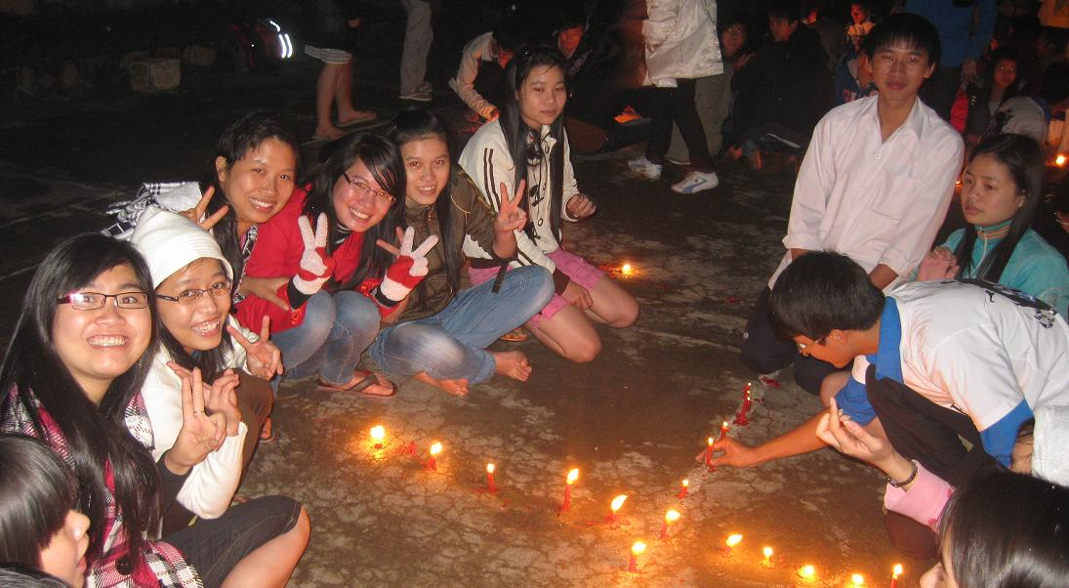
Youth are the best Change Agents, because:
They are motivated by strong ideals
They are willing to take risks
They have a lot of energy
They are trend-setters for others
And they are highly communicative.
But they lack power, technical knowledge, and material resources.

Slide 5
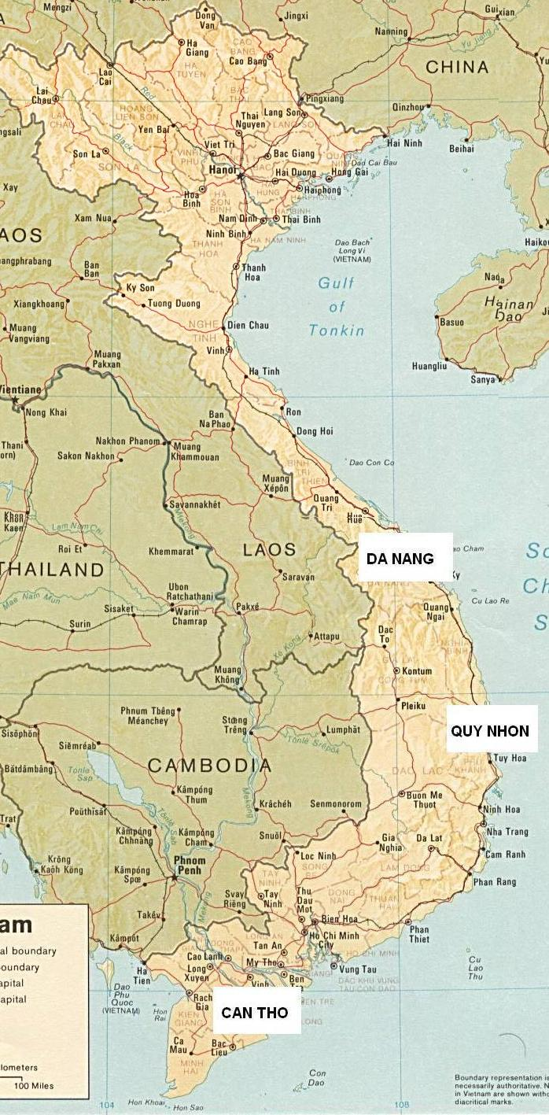
AYIP (the ACCCRN Youth Initiatives Program) is funded by the Rockefeller Foundation under the Asian Cities Climate Change Resilience Network (ACCCRN).
AYIP is implemented by CtC and the Vietnam Youth Union in Quy Nhon, Da Nang and Can Tho cities.
AYIP enables Urban Youth aged 16 to 25 to implement their own climate change adaptation initiatives.
About 15 to 20 Youth Groups are supported to implement initiatives of value between USD 500 and USD 5,000, from April 2012 to July 2013.

Slide 6
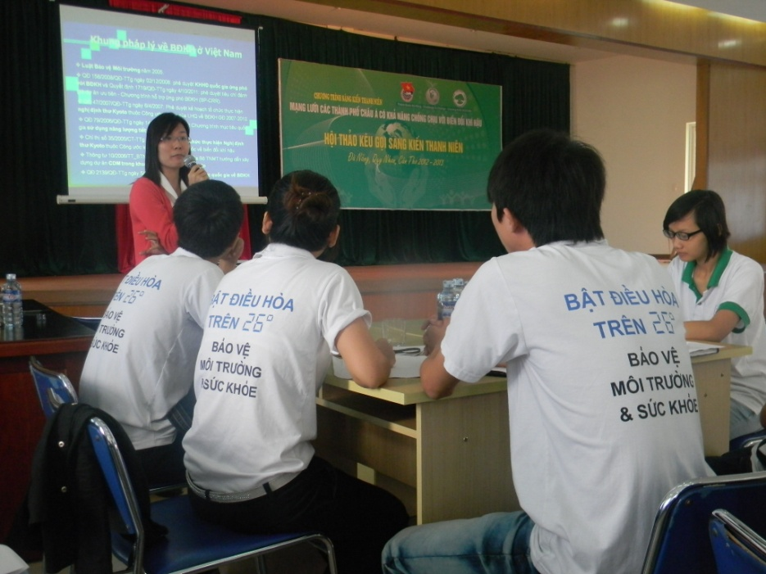
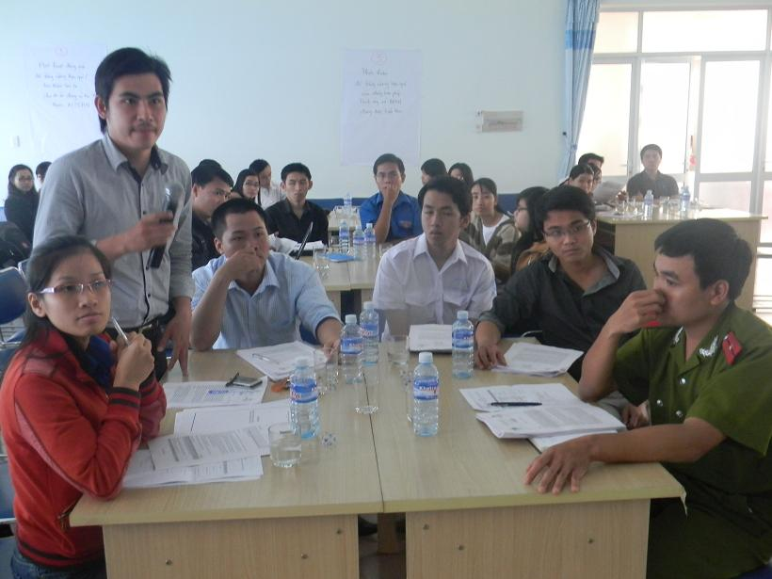
AYIP also encourages active collaboration between government agencies and Youth Groups in the three cities.
This enables Youth to learn about climate change initiatives, and enables government agencies to see climate change from a new angle.

Slide 7
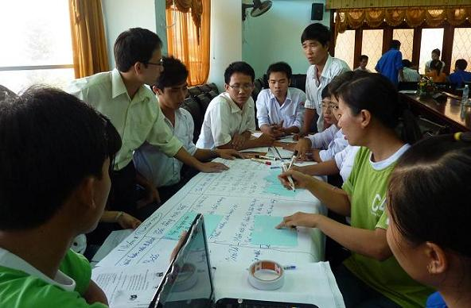
AYIP is just beginning in mid 2012. Proposals from Youth for their initiatives include:
Support to a vulnerable neighbourhood or community, to analyse their vulnerabilities and elaborate solutions
Research into existing ways people are adapting to climate change
Support to enhance existing community-based adaptation
Support to new adaptation/resilience initiatives
Adding value to existing government or ACCCRN climate change initiatives
Documentation of a climate issue in the city
Start-up of a longer term cooperation, network or service for urban climate change resilience

Slide 8
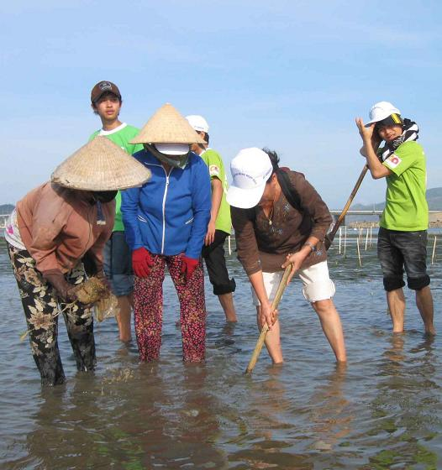
Youth Unions makes video-documentation of their climate change initiatives. AYIP provides each city Youth Union with a video camera, and provides digital film editing training.
The program takes advantage of Youth characteristics as good Change Agents and trend-setters who are highly communicative.
In this way Youth communicate their ideas and values, and we see climate change resilience through their eyes.

Slide 9
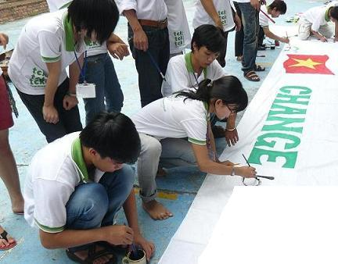
AYIP Key Outcomes are:
The enhancement of Youth rights to address climate change, (Rights-Based Approach), and the emergence of Youth climate champions
An understanding of urban climate change resilience (UCCR) through the eyes of Youth
The spread of climate change awareness through existing Youth networks using multiple media, creating conditions for community-based adaptation.

